Slide 1
TiO2-based Building Materials
Student: Pan Shengjie
(2013011712 class S42)
2015/12/10
、
DEPARTMENT OF CIVIL ENGINEERING
TSINGHUA UNIVERSITY
Notes:
魏老师，各位同学，大家早上好。很荣幸有机会在这里更大家汇报我的调研主题：TiO2-based Building Materials 简写是TBM。

Slide 2
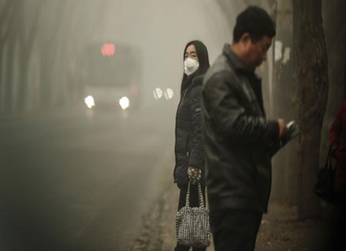
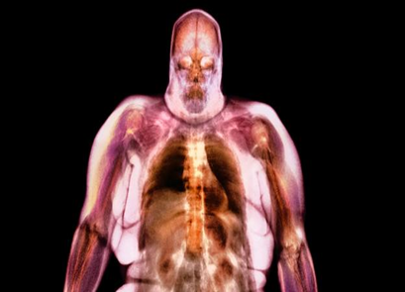
1 Smog !!!
Composition: organic(40%), sulfate(17%), nitrate(14%), etc.
Danger: led to the death of 670,000 people in 2012.
Notes:
可能大家最近对雾霾深有体会 现在就要说到

Slide 3
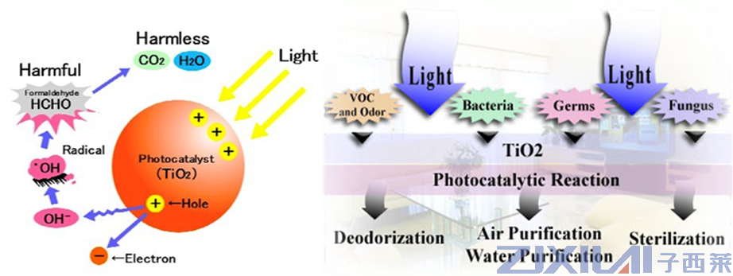
2 Photoactive property of TiO2
1972 Fujishima found water can be split into H2 and O2 by TiO2, and then many photoactive properties of TiO2were further observed.
it can decompose many kinds of air pollutants (hydrocarbons, aldehyde， halogenated compounds, nitrogen-containing compounds，sulfur-containing compounds, and inorganic compounds.
Notes:
幸运的是……种类较多：碳氢化合物、甲醛、卤化物、氮氧化合物、硫化物

Slide 4
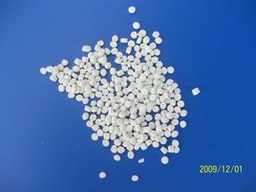
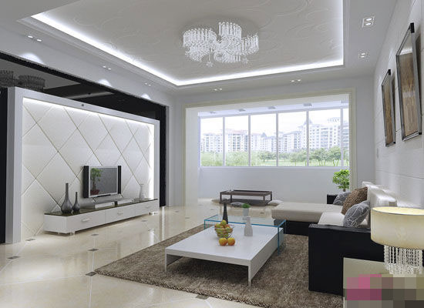
3 combination of TiO2 and building materials
TiO2 ：a kind of nontoxic, stable and inexpensive building materials.
Photoactive properties：photocatalysis, photoinduced superhydrophilicity.
Size : nanoparticles or nanometer thin films
Method：mixing or coating
Notes:
光催化 光敏亲水性 纳米颗粒、纳米薄膜才有催化作用。意大利 金铂莱利瓷砖

Slide 5
4 Air-cleaning TBMs
Experiment
i) Maggos: NO and NO2--19 and 20%
ii)Salthammer: formaldehyde 1.2 mg/m3 influent -- 0.4 mg/m3 effluent
indoor air pollutants
outdoor air pollutants (ultraviolet light)
Benefit: unpowered air-cleaning system
Notes:
Maggos:密闭车库内的墙涂满含有二氧化钛光敏材料的涂料，发现车库里的浓度下降。Salthammer在立方体内涂上类似涂料，一段时间后 甲醛浓度变化。

Slide 6
5. Problems and future
(i) Effective regeneration methods for inactive TBMs.
(ii) The properties of TBM would be changed by the addition of TiO2.
(iii) improve the photoactive performances of TBMs and enhance the stability of TBMs.

Slide 7
references
Carp O, Huisman C L, Reller A. Photoinduced reactivity of titanium dioxide. Prog Solid State Ch, 2004, 32(1-2): 33―177
Fujishima A, Honda K. Electrochemical photolysis of water at a semiconductor electrode. Nature, 1972, 238: 37―38
Maggos T, Bartzis J G, Liakou M, et al. Photocatalytic degradation of NOx gases using TiO2-containing paint: A real scale study. J Hazard Mater, 2007, 146: 668―673
Salthammer T, Fuhrmann F. Photocatalytic surface reactions on indoor wall paint. Environ Sci Technol, 2007, 41(18): 6573―6578
Seo J W, Chung H, Kim M Y, et al. Development of water-soluble single-crystalline TiO2 nanoparticles for photocatalytic cancer-cell treatment. Small, 2007, 3(5): 850―853

Slide 8
End
Your comments and criticism are greatly welcomed!
Thank you!

